Slide 1


Analysis on
Social Buzz’s
Top Content Category

Slide 2


Today's agenda
Project recap
Problem
The Analytics team
Process
Insights
Summary

Slide 3

Social Buzz, founded by former engineers from a leading social media giant, prioritizes content over user identity, fostering engagement through over 100 reaction types. With 500 million monthly users and massive daily content, they seek expert advisory to navigate their rapid growth and complex data management needs.
To assist with their data challenges, Accenture initiated a 3-month project covering:
Project Recap
Audit of big data practice,
Recommendations for IPO,
Analysis of popular content

Slide 4

Problem
With 500 million monthly users and massive daily content -
More than 1,00,000 post per day
36,500,000 pieces of content per year
Analysis to find Social Buzz’s top 5 popular content

Slide 5



Tasnima Aktar
Data Analyst
The
Analytics team
Marcus Rompton
Senior Principle
Andrew Fleming
Chief Technical Architect

Slide 6
Data Understanding
Process
1
Data Cleaning
2
3
Data Modeling
4
Data Analysis
5
Present Insights

Slide 7
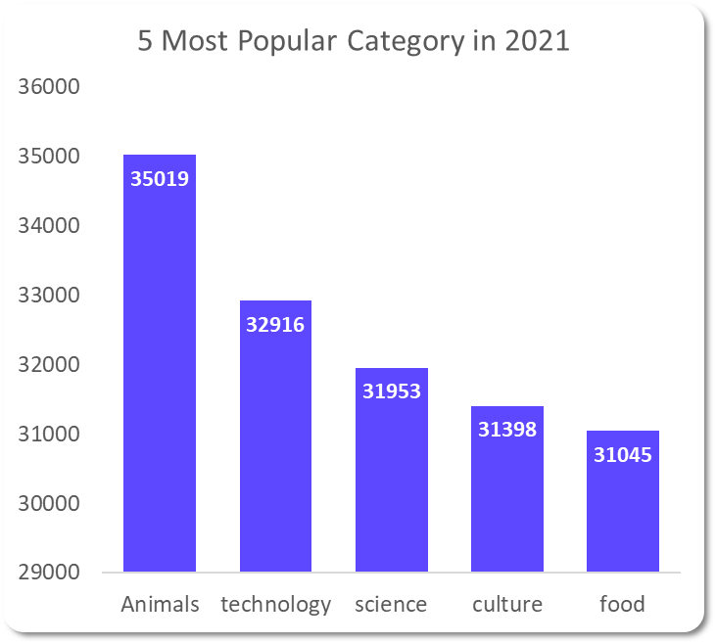
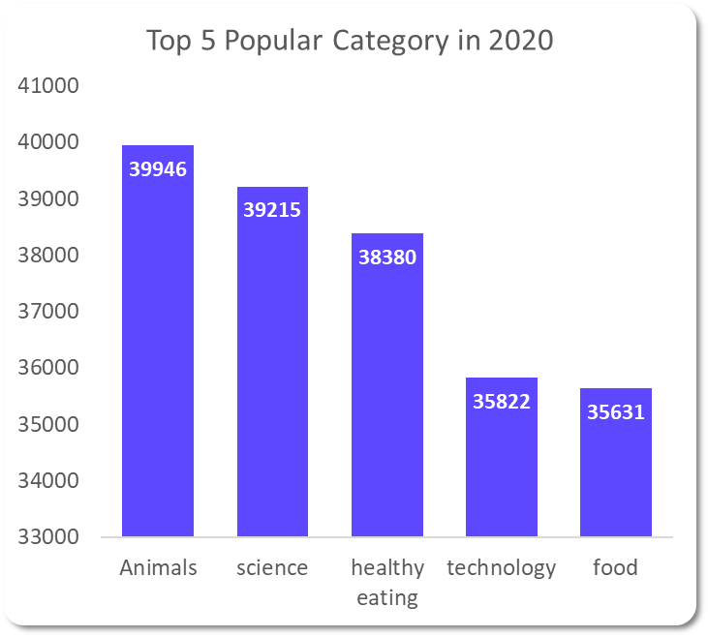
Insights

Slide 10


Based on our analysis,
Animals consistently lead in popularity, indicating a strong, sustained user interest, significantly leading with 74,965 reaction score.
Science and Technology are stable favorites, showing increasing interest about technology.
We saw Healthy Eating increased engagement in 2020, possibly due to the pandemic. However, food was always there in the top 5. You can use this insight to create a campaign with food and healthy eating to boost user engagement.
The appearance of Culture in 2021 indicate shifting interests and trends over time.
Summary
This ad hoc analysis is helpful. However, to dig in deeper level we need to take this analysis in large scale production for real-time understanding. We can help you with that.

Slide 11
Thank you!
ANY QUESTIONS?

